Slide 1
Puppetry
Historical Development and Position Today

Slide 2
Origins: Toys, dolls and automata
Toys and dolls are often thought to be the ancestors of the puppet. This is indicated when we examine the etymology of the word "puppet" in several Indo-European languages.
Richard Pischel, the renowned German Orientalist, describes the words for puppet in the ancient language of India: "The words for puppet in Sanskrit are putrika, duhtrika, puttali, puttalika, all of which mean ‘little daughter'.“
To this, William Ridgeway remarks: "The use of such terms as ‘little daughter' or ‘little girl' for puppets is not peculiar to the Hindus, since the regular Greek term kore (which does not occur earlier than the fourth century before Christ), as well as the latin pupa and pupula all mean ‘little girl'."
Gustave Schlegel in his review of Stuart Culin's 1895 book Korean Games with notes on the corresponding games of China and Japan , states poupée "is derived from the Latin pupa, a girl (Comp[are]. pupus, a boy, pupulus, a little boy - all derived from the S[ans]k[ri]t. root push, to nourish.)“
Poupée being the word for doll in French, and perhaps one of the derivations for the English word for puppet, we can now see clearly why dolls and puppets are considered closely related to each other. In many other Indo-European languages, frequently an identical word is used to mean either "puppet", or "doll": in Italian bambola, in Polish lalka, in German Puppe, in Latin pupa, etc. This is also true of many Indian languages

Slide 3
The Symbolic Strength of Puppets
The puppet has a special strength as it plays on several realities: firstly, before the puppet becomes animated, the viewer can imagine what it will come to represent. Whether it be about the reality of the strength that it ought to demonstrate in animistic magic, or one of the imaginary universe in traditional theater acting, puppets have that advantage as a medium. They also have the particularity to be only an object. This double nature makes the mystery sensitive and reflects all imaginations, but, once it’s labor's over, it remains a perfectly disembodied shape.

Slide 4
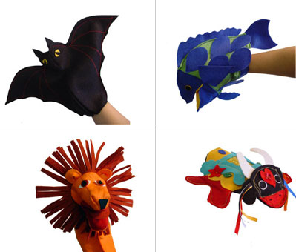
Types of puppets
Hand Puppets

Slide 5
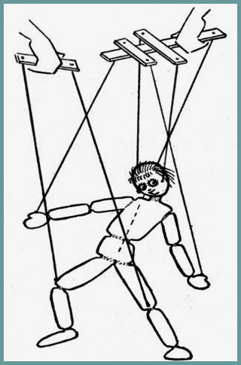
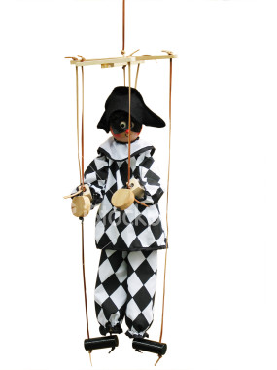
Marionettes

Slide 6
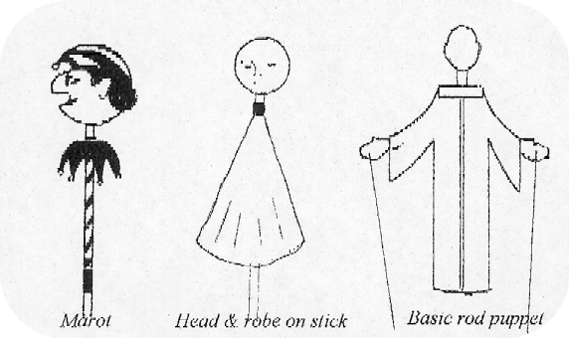
Rod Puppets

Slide 7
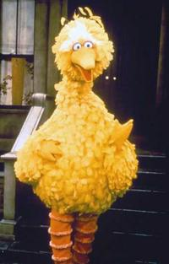
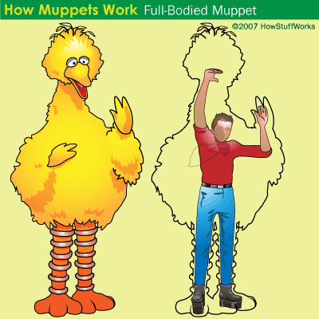
Muppets

Slide 8
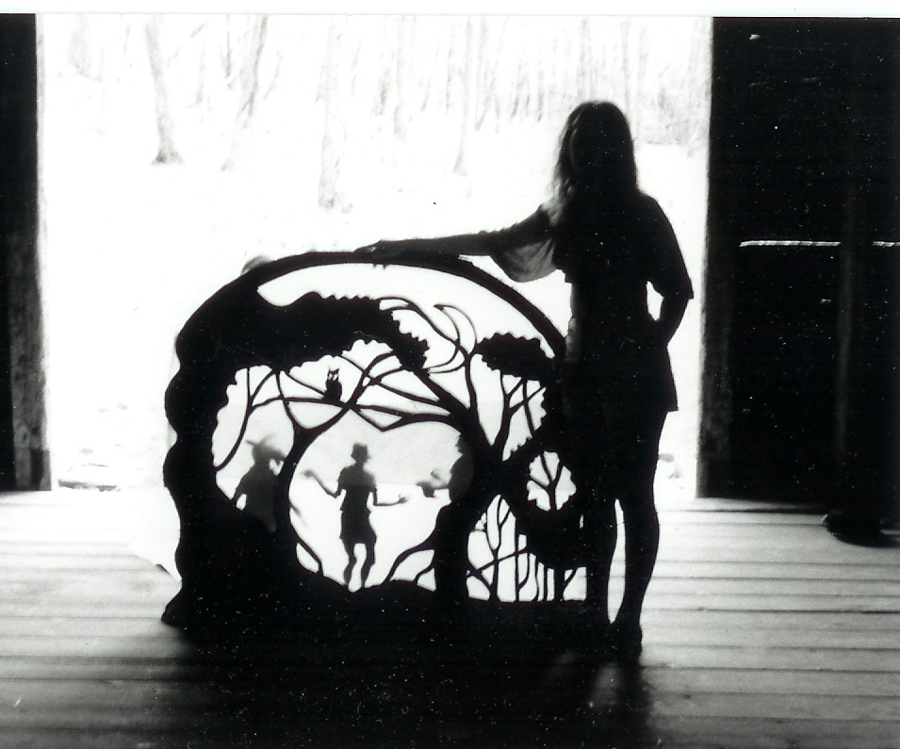
Shadow Puppets

Slide 9
Compound Puppets
Notes:
In which all kinds of puppets are gathered called compound puppets.

Slide 10
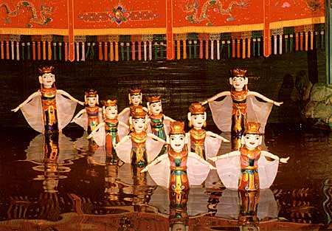
Puppetry needs:
Puppet
Puppeteer
Stage or
Notes:
Water Puppets.
Material is water resistance.

Slide 11
Puppetry in History
India
Egypt
Indonesia
China
Japan
Greece
Rome
Turkey
France

Slide 12
India Limestone figure Harappa Way before the time of the epics like Mahabharata, the people of Indus Valley made small limestone figurines which suggests movable parts. Also there were animal toys which moved their necks (bullock Carts)

Slide 13
Articulated Indian Figurine: Stick Puppets, animated figures and pantomime coexist: their role was improvised on epic mythological Indian themes: the Bala-Ramayana and the Maha-Bharata. Although these performances were sacred, the comedic spirit was also present. The popular aspect of the puppet show can be attributed to the profane elements in it, giving birth to the jester trend

Slide 14
Dancing dwarfs in ivory. The figures move through the use of strings and a pulley. Found at Lisht during excavations in 1934 by the Metropolitan Museum of Art,

Slide 15
EGYPT Height - 7.8 cm. Egypt - Middle Kingdom - 12th Dynasty

Slide 16
Indonesia
In Indonesia, puppet shows have developed a style of their own: the walangs'. Puppets are mounted on a stem made out of a bone or wood with articulated arms at the elbow and shoulder, using sticks attached to the wrists. The Dalang, a priest-like person, opens the ceremony with an offering. Then, accompanied by percussion, he recites and sings his story, agitating his walangs, aiming to compel the dead to respond to his calling.

Slide 18
In Indonesia today, puppetry has a great hold on the people. It is in this country that puppets are held in greater esteem than anywhere in the world. Everyone knows all the puppet characters and plays. Here, the most popular of all forms of puppetry is the wayang kulit purwa (kulit means "leather", and purwa means "old" or "ancient", so "ancient shadows of leather"): vv

Slide 19
Wayang kulit, shadow puppets, [are] the most common of all the wayang figures. They are about two feet high and are made from delicately patterned buffalo hide, the design being chiseled out of the leather and then the whole figure painted and gilded. Every aspect of the puppet's design is set down by tradition and is related to the character portrayed. Thus the audience gathers all the necessary information about the puppet's character from its appearance. Even the angle of the head is significant.
Wayang Klitik, left. Wooden rod puppet.

Slide 20
Wayang Golek Indonesian puppet in the round ( Rod Puppet )

Slide 21
A Wayang Beber Performance, 1900
Notes:
The Javanese puppeteer, the dalang, presents his shadow show from dusk to sunrise. The role of the dalang has been likened to that of the priest as in Java puppets are thought to be the incarnation of ancestral spirits, and thus the dalang is a medium between the spirits and his audience. He manipulates the puppets, speaks all the dialogue, and conducts the gamelan, the percussion orchestra which sits behind him. The dalang's cotton screen, or kelir, is supported by bamboo sticks and is about five feet high and up to fifteen feet long. Two long stems of banana plants, placed along the bottom of the screen, are used to hold the puppets' rods when they are off stage, the good characters on the right, the evil on the left. Until recently it was traditional for the men of the audience to sit behind the dalang and watch the actual puppets whilst the women sat in front of the screen and watched the shadows cast by the light of an oil lamp on the beautiful figures [Currell].

Slide 22
Wayang Kulit Performance in Java. The dalang is seated in front of the white screen (kelir) to the far left. He requires several assisants to hand him his puppets, ranged along the banana tree trunks, to the left and right of the dalang.

Slide 23
Modern day puppet master or “ Dalang”, Indonesia

Slide 24
China

Slide 25
China
In China, a thousand years before Jesus Christ, the religious essence of puppetry was progressively replaced by a shared repertory between popular jestering and chivalrous melodrama.
With the exception of Kvo's character, a type of Vidouchaka, high spirited and full of verve, they did not have any typical character. They also did not have a repertory based around one specific character like they had in Europe. This is proof of the originality of their art, also widely reinforced by the puppeteers' amazing dexterity.
The Art of Puppetry in China found a unique and peerless ascension, through the number of styles and in its variety of methods. Puppets are still very popular: a few years back, more than a thousand puppet theater companies were listed!

Slide 26
Chinese rod puppets

Slide 27
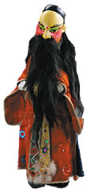
Chinese Puppets

Slide 28
Chinese Dragon dance

Slide 29
Chinese lion dance

Slide 30
Japanese Bunraku puppets

Slide 33
Roman Doll in Ivory

Slide 34
Karakouche.
With Islam, the impossibility of representing the human being flesh and blood favored the "shadow game". Around the XVIth century, a comedy of relaxed virtues where an everyday life satirist approach had its place, organized itself around the character of Karagöz. Bold head, wearing a high cap, fat belly, hunchback, submissive to his own instincts of hunger and luxury, he broke the law. Born in Turkey, he conquered the Mediterranean basin from Greece where he was called Karaghiozis, to Tunisia and Algeria, where he was then named Karagouz et Karakouche.
Turkey

Slide 35
Puppetry in the Contemporary world
Jim Henson,
Puppetry in Theatre ( The Lion King) Mixture of Mediums
Local , Farooque Qaiser
Rafi Peer Theatre
Puppeteers NCA

Slide 36
Rafi Peer theatre

Slide 37
Farooq Qaiser

Slide 38
Puppeteers NCA
Puppeteers NCA Puppeteers NCA was inaugurated in 1992 with the first director Imran Qureshi and fellows. The basic goal of this society is to exhibit and perform in different mediums of puppetry along with researching new techniques. We perform in the following puppet handling techniques:- Finger puppet Hand puppet Muppets We use the following mediums:- Black light Shadow puppets Claymation We have recently performed for Rafi peer Theatre, Nestle, Roll’em society and for Cultural Dramatic Entertainment Society, GIK Some of our performances are:- Bubloo Lights Out Last Supper Josh Ki Inteha 1+1=4

Slide 39
New Place of Puppetry
Puppetry in Films
Chucky
Robotics, Jurassic park
Star Wars
Clamation
Wallace and Gromit
Corpse’s Bride
Making of (Clamation)
Virtual Puppets

Slide 40
Puppetry in theatre

Slide 44
Puppets in films

Slide 45
Puppets and Robotics

Slide 46
Clamation

Slide 48
Assignment:
You will be shown three kinds of presentations of puppetry.
Puppetry in Theatre
Puppetry in Film
Puppetry in Animation
Define the Puppet, Puppeteer and the Proscenium in all three. How do they explore the realm of puppetry? Design an idea for a puppet show which incorporates all three.

